Slide 1
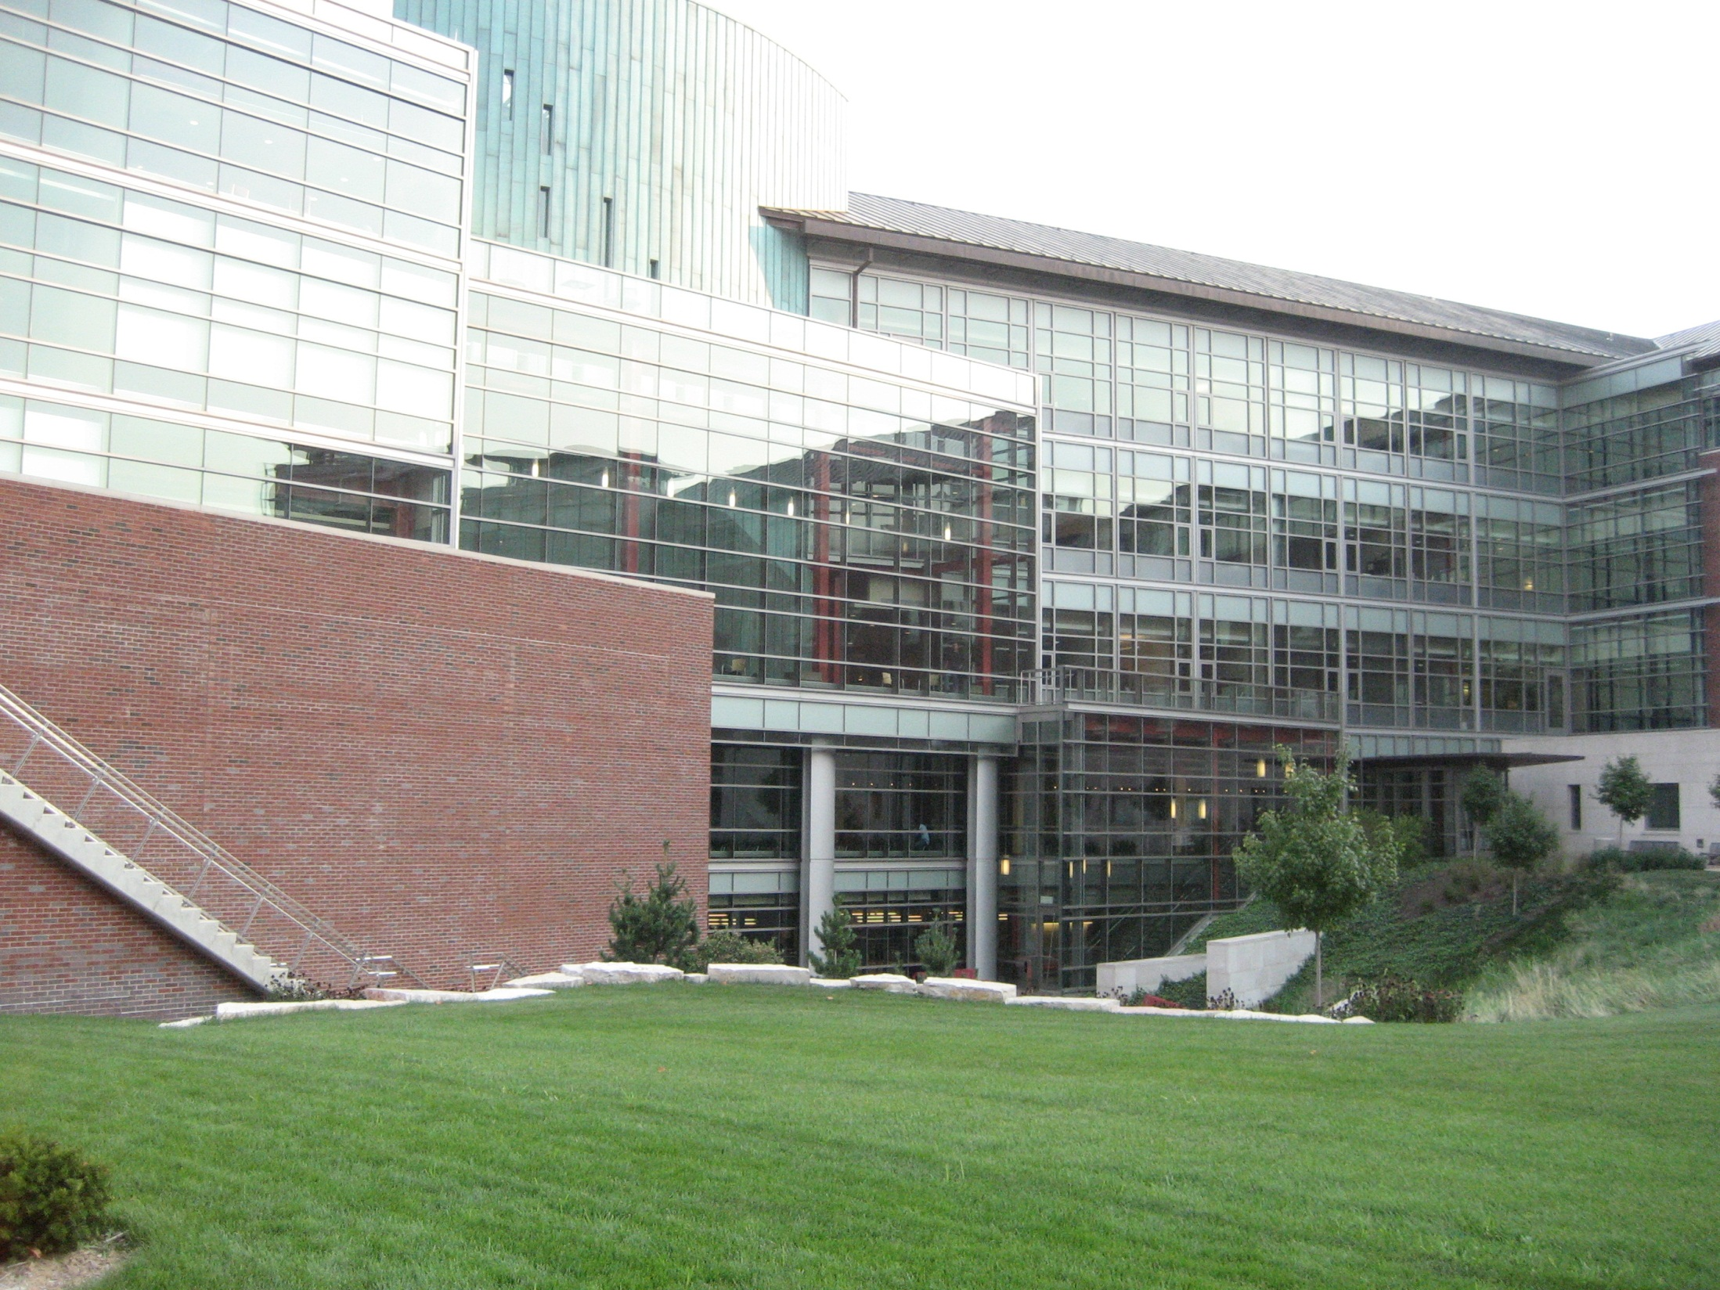

Slide 2
Course Overview
Jiawei Han
Department of Computer Science
University of Illinois at Urbana-Champaign
November 7, 2026

Slide 3
Data and Information Systems
(DAIS:) Course Structures at CS/UIUC
Three main streams: Database, data mining and text information systems
  Yahoo!-DAIS Seminar: (CS591DAIS—Fall and Spring) 4-5pm Tuesdays
Database Systems:
  Database management systems (CS411: Fall and Spring)
  Advanced database systems (CS511 Kevin Chang: Fall)
Data mining
  Intro. to data mining (CS412: Han—Fall)
  Data mining: Principles and algorithms (CS512: Han—Spring)
  Seminar: Advanced Topics in Data mining (CS591Han—Fall and Spring) 4-5pm Thursdays
Text information systems
  Introduction to Text Information Systems (CS410: Zhai—Spring)
  Advance Topics on Information Retrieval (CS 598: Zhai—Fall)
Bioinformatics
  Introduction to Bioinformatics (CS466: Saurabh Sinha—Spring)
  Probabilistic Methods for Biological Sequence Analysis (CS598:Sinha)

Slide 4
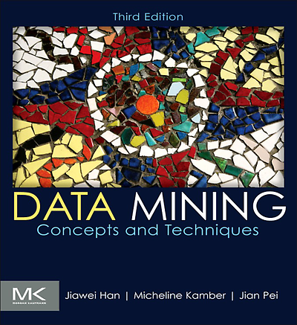
Topic Coverage of CS512
Textbook: Han, Kamber, Pei. Data Mining: Concepts and Techniques. Morgan Kaufmann, 3rd ed. 2011
  Chaps. 1-10: covered in CS412
  Chaps. 11-12: CS512 (Chap. 13: self reading)
    Chap. 11: Advanced Clustering Methods
    Chap. 12: Outlier Analysis
Additional themes to be covered in 2012 Spring
  Introduction to network analysis (ref: Newman, 2010 textbook)
  Mining information networks (ref: research papers + slides)
  Mining data streams (ref. 2nd ed. Textbook (BK2): Chap. 8)
  Mining sequence and time-series patterns (ref. BK2: Chap. 8)
  Graph mining: patterns & classifications (ref. BK2: Chap. 9)
  Spatiotemporal and moving object data mining (ref: BK2: Chap. 10)
  Not covered: Text/Web mining, etc. (ref: BK2: Chap. 10, Prof. Zhai’s classes)

Slide 5
Class Information
  Instructor: Jiawei Han (www.cs.uiuc.edu/~hanj)
  Lectures: Tues/Thurs 9:30-10:45am
  Office hours:
    Tues/Thurs. 10:45-11:30am
Teach Assistant: Bolin Ding
Prerequisites (course preparation)
  CS412 (offered every Fall) or consent of instructor
  General background: Knowledge on statistics, machine learning, and data and information systems will help understand the course materials
Course website (bookmark it since it will be used frequently!)
  https://wiki.engr.illinois.edu/display/cs512/Lectures
Textbook:
  Jiawei Han, Micheline Kamber, Jian Pei, Data Mining: Concepts and Techniques, 3rd ed., Morgan Kaufmann, 2011
  Other reference materials (see course syllabus)

Slide 6
Course Work: Assignments, Exam and Course Project
Assignments: 15% (2 assignments in total)
Class presentation: 5%
  On-campus student: Theme-related presentation: (Each presentation may take 10-15-minutes, high quality slides and presentation) Presentation should be closely related to class contents
  Online students: Slides for your survey report
Two Midterm exams: 40% in total (20% each)
Survey report: 10% [no page limit, but expect to be comprehensive and in high quality]
  Encourage to have similar topic as your research topic
Final course project: 30% (due at the end of semester)
  The final project will be evaluated based on (1) technical innovation, (2) thoroughness of the work, and (3) clarity of presentation
  A one-page proposal will be due at the end of the 4th week
  The final project will need to hand in: (1) project report (length will be similar to a typical 8-12 page double-column conference paper), and (2) project presentation slides (which is required for both online and on-campus students)
  Each course project for every on-campus student will be evaluated collectively by instructor (plus TA) and other on-campus students in the same class
  The course project for online students will be evaluated by instructors and TA only

Slide 7
Survey Topics
To be published at our book wiki website as a psedo-textbook/notes
  Stream data mining
  Sequential pattern mining, sequence classification and clustering
  Time-series analysis, regression and trend analysis
  Biological sequence analysis and biological data mining
  Graph pattern mining, graph classification and clustering
  Social network analysis
  Information network analysis
  Spatial, spatiotemporal and moving object data mining
  Multimedia data mining
  Web mining
  Text mining
  Mining computer systems and sensor networks
  Mining software programs
  Statistical data mining methods
  Other possible topics, which needs to get consent of instructor

Slide 8
Textbook & Recommended Reference Books
Textbook
  Jiawei Han, Micheline Kamber, Jian Pei, Data Mining: Concepts and Techniques, 3rd ed., Morgan Kaufmann, 2011
Recommended reference books
  C. M. Bishop, Pattern Recognition and Machine Learning, Springer 2007.
  S. Chakrabarti, Mining the Web: Statistical Analysis of Hypertext and Semi-Structured Data, Morgan Kaufmann, 2002
  T. Hastie, R. Tibshirani, J. Friedman, The Elements of Statistical Learning: Data Mining, Inference, and Prediction,2nd ed., Springer-Verlag, 2009.
  B. Liu, Web Data Mining: Exploring Hyperlinks, Contents, and Usage Data, Springer, 2006
  D. Easley and J. Kleinberg, Networks, Crowds, and Markets: Reasoning About a Highly Connected World, Cambridge Univ. Press, 2010.
  M. Newman, Networks: An Introduction, Oxford Univ. Press, 2010.

Slide 9
Reference Papers
Course research papers: Check Reading_List
Major conference proceedings that will be used
  DM conferences: ACM SIGKDD (KDD), ICDM (IEEE, Int. Conf. Data Mining), SDM (SIAM Data Mining), PKDD (Principles KDD)/ECML, PAKDD (Pacific-Asia)
  DB conferences: ACM SIGMOD, VLDB, ICDE
  ML conferences: NIPS, ICML
  IR conferences: SIGIR, CIKM
  Web conferences: WWW, WSDM
Other related conferences and journals
  IEEE TKDE, ACM TKDD, DMKD, ML,
Use course Web page, DBLP, Google Scholar, Citeseer
CS591Han: Advanced Seminar on Data Mining

Slide 10
Research Frontiers in Data Mining
Mining social and information networks
Mining spatiotemporal data, moving object data & cyber-physical systems
Mining multimedia, social media, text and Web
Data software engineering and computer system data
Multidimensional online analytical analysis
Pattern mining, pattern usage, and pattern understanding
Biological data mining
Stream data mining

Slide 11
